Slide 1
Analytics
Chapter 3

Slide 2
Analytics
Analytics or data analytics is the computer science discipline of analysing and interpreting data.
Most computer science applications amass a lot of data over time.
For example a medical system could store millions of instances of data in seconds.
The goal of Analytics is to process and transform the data, present the data in a meaningful way and finally interpret the data.

Slide 3
Data Analytics
Terms that are similar:
Data Analytics
Data Analysis
Data Mining
Data Science

Slide 4
Data
Data is the term used to typically represent raw data, from sources such as a CSV file, a List or data from a database.
It is typically in a form that is of no use to a computer scientist.
Pre-processing is usually the next step.

Slide 5
Pre processing
One of the first things that computer scientists exam are outliers - for example someone could have accidently typed an extra zero when entering an age resulting in 200 and not 20.
A simple method is to remove that value.
Another pre processing method is to sort the data.
This is useful to get the max and min values or getting ready to count frequency.

Slide 6
Information
Information usually refers to gathering or presenting the data for the user.
This typically requires presenting the data visually such as a graph or a figure.

Slide 7
Analysis
Even with information the fine details are not always obvious.
Information is a great aid for presenting your findings, but algorithms can be more accurate when interpreting the data.
Algorithms such as frequency, mean, median, minimum, maximum and mode of data can really add clarity and help interpret the data.

Slide 8
Data - Python Lists
Lists in Python are fundamental in analytics. Even if our data is stored in a 2D list (like a database), most algorithms such as frequency, mean, median and mode can be calculated on a 1D list.

Slide 9
Text Files
Text files are one of the most versatile files for computer scientists.
Example of creating a text file and entering data.
file = open(“myFirstTextFile.txt”,”w”)
file.write(“Test text”)
file.close()

Slide 10
file = open(“myFirstTextFile.txt”,”w”)
The first line allows access to the file. If the file does not exist, Python automatically creates it for you.
File (on the first line) is just a variable name. The open method takes two arguments:
The first argument is a string that is the file name. You also need the file extension. For a text file, this is .txt.
The second argument is what you are doing with the file. There are three options:
“w” - write. This will overwrite any previous contents.
“a” - append. This adds the text to the end of the current contents.
“r” - read. This read the contents of the file as a string.

Slide 11
file.write(“Test text”)
The second line of code, we pass a string in as an argument to be written to the file.
file.close()
The third line of code closes the connection to the file.
Python must request to open a file, it must also say when it is complete and release the file. If you don’t then you may get an error when trying to use this file again.

Slide 12
Reading the file
To read in the same file we just created, we could do the following:
file = open(“myFirstTextFile.txt”, “r”)
dataIn = file.read()
file.close()
print(dataIn)

Slide 13
CSV files
While text files have their uses, they are not the most suitable for storing data, especially large amounts of data.
A CSV file is essentially like a .txt file. It uses the same Unicode/ASCII structure.
CSV stands for “comma separated values”
Computer Scientists like this format for the following reasons:
Quick to read and write to in Python
Excel has a row limit of 1,048,576 rows
The file can be used even if you do not have excel on your computer.

Slide 14
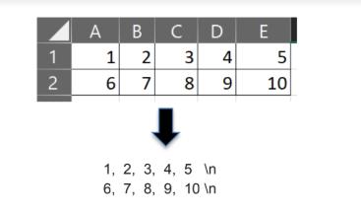
CSV Structure
The structure of a CSV file is relatively simple but the format can cause some issues:
Commas separate elements on a row. These are called delimiters.
A new line special character “\n” represents the end of a row and the start of a new row.

Slide 15

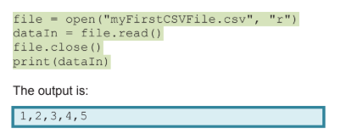
Reading and Writing to CSV file
Reading and Writing to a csv file can be done the same way as for a text file. You just need to change the file extension.

Slide 16
The code in the previous slide prints a string for us. This is not really useful if we want to find a total or an average etc.
We know that every element is separated by a comma in a csv file.
We can use this to our advantage and write a loop to go through the string and take out elements with a comma in between them.
This sounds complicated but Python has a method for doing this - it can separate a string into a list based on any specified delimiter (in our case it’s a comma)

Slide 17
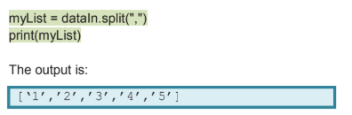
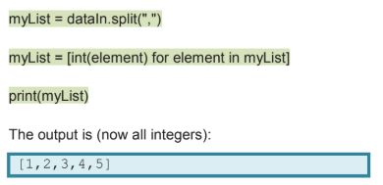
The .split() method takes the delimiter as an argument.
Notice that all the elements in the list are strings.
We can convert each element to an int so that we can do calculations on them. Python has an easy way to do this.

Slide 18
Pre-Processing and Transforming Data
Pre-Processing allows to apply techniques to ensure the data is of good quality.
Typical errors in data that require pre-processing are:
Missing data
Data out of range
Non validated data
Data structure incorrect

Slide 19

Sorting
Sorting is useful for many reasons. If you sort, you will know the largest and the smallest are the first and the last value of the list.
myList = [1,19,27,8,5,9]
myList.sort()
print(“Sorted Ascending:” myList)
myList.sort(reverse = True)
print(“Sorted Descending:” myList)

Slide 20

Removing Missing Data
Sometimes data in a list could be identified as an error and may need to be removed.
For example if a list should only contain positive numbers and a negative number is present.
A pre-processing step could be to remove all negative numbers
myList = [1,-19,27,8,-5,9]
for item in myList:
if item<0:
myList.remove(item)
print(myList)

Slide 21
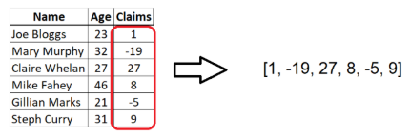
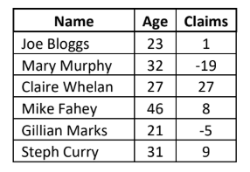
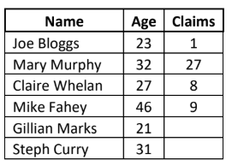
Imputing Missing Data
Imputing data is an option instead of removing missing data.
Sometimes removing data is not an option, especially in a 2D list as there is other data associated with it.

Slide 22
Imputing Missing Data
We can go through a list and replace all values with a number.
Imputing is an algorithm that finds the average of all non missing values and then replaces the missing values with the average of the group.
There are two parts:
First find the average of all non missing values
Second replace all error values with the calculated average

Slide 23
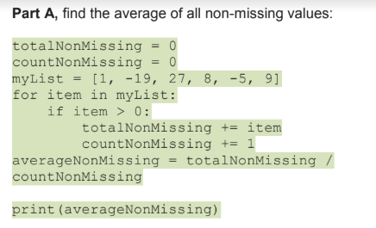
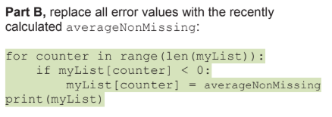



Slide 24
Cleaning/Pre-processing Data
In the programs we do, the most common cleaning involves one of the following:
Remove unwanted characters such as a comma in the middle of a number
Select only part of the data in a column
Examples of each of these are here:
Remove unwanted characters
Select part of the data in a column

Slide 25
Data Analytics Algorithms
Python is one of the most popular languages for Analytics in 3rd level and industry. One of the main reasons for this is the speed at which you can conduct Analysis such as getting the maximum and minimum values of a list.
We can also use the statistics library to find the mean, median and mode or we can code these without the use of a library.

Slide 26
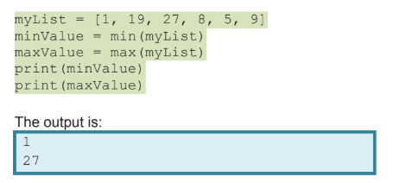
Max and Min Values
Method 1: Using Inbuilt functions

Slide 27
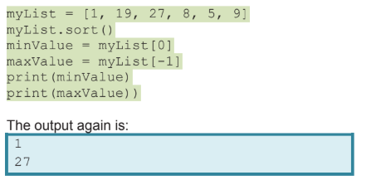
Max and Min Values
Method 2: Using Sorting and extracting the First and Last Value

Slide 28
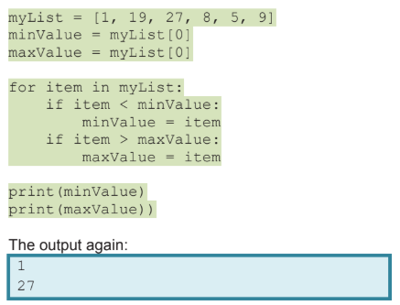
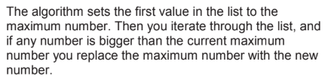
Max and Min Values
Method 3: Manually Coding

Slide 29
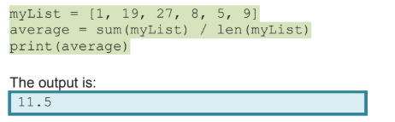
Mean
Method 1: Using sum() and len()

Slide 30
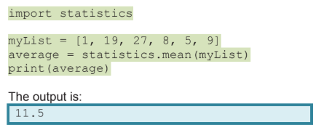
Mean
Method 2: Using statistics library

Slide 31
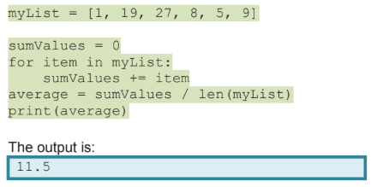
Mean
Method 3: Manually Coding

Slide 32
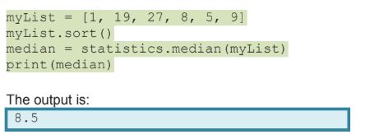
Median
Method 1: Using the statistics library

Slide 33
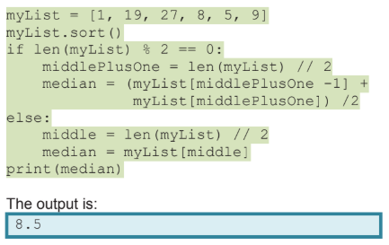
Median
Method 2: Manually Coding
Note: The median is the middle number of a sorted list.
If there is an even number of elements in the list then the median is the middle two numbers added together and divided by 2.

Slide 34
Frequency
Frequency is the number of times elements appear in a list, this can be for strings or numbers.

Slide 35
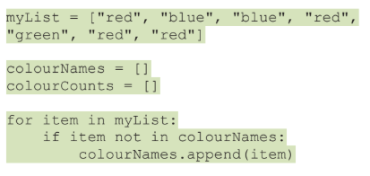
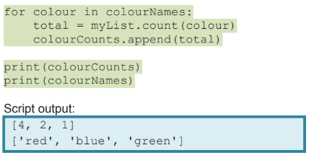
Frequency
Creates two empty lists
Loops through myList. If the item is not already in the colourNames list then add it to the list.
Loops through the colourNames list and counts the amount of times each colour is in myList

Slide 36
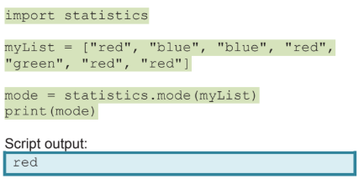
Mode
Mode is the value that occurs most often in the dataset.
Method 1: Using statistics library

Slide 37

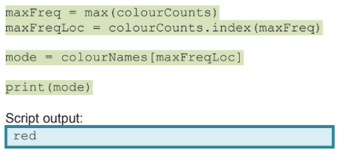
Mode
Method 2: Manually Coding

Slide 38
Mean
Method 2: Using statistics library

Slide 39
Mean
Method 3: Manually Coding

Slide 40
Median
Method 1: Using the statistics library

Slide 41
Median
Method 2: Manually Coding
Note: The median is the middle number of a sorted list.
If there is an even number of elements in the list then the median is the middle two numbers added together and divided by 2.

Slide 42
Frequency
Frequency is the number of times elements appear in a list, this can be for strings or numbers.

Slide 43
Frequency
Creates two empty lists
Loops through myList. If the item is not already in the colourNames list then add it to the list.
Loops through the colourNames list and counts the amount of times each colour is in myList

Slide 44
Mode
Mode is the value that occurs most often in the dataset.
Method 1: Using statistics library

Slide 45
Mode
Method 2: Manually Coding

Slide 46
Visualisation/Graphing
It is easy to create visualisations in Python using a module named matplotlib.
We need our data in a list(s) to be able to create a graph.

Slide 47
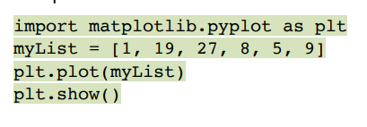
Plotting graphs
The first line uses an interface pyplot, from the matplotlib module. It is mainly used for interactive plots and simple plot generation, which is what we want.
We import as plt so that we don’t have to type matplotlib.pyplot every time we want to use it. We can just type plt instead.

Slide 48
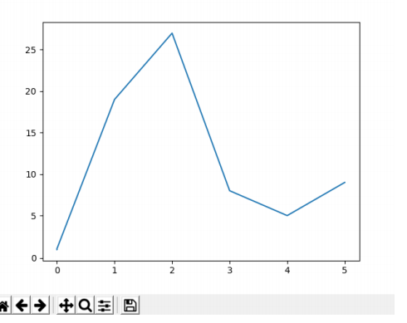
The output looks like this

Slide 49
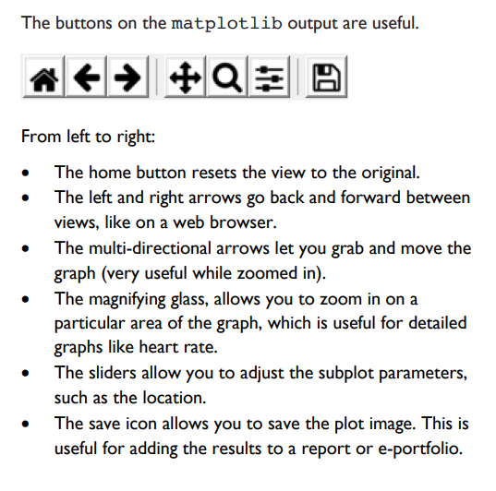

Slide 50
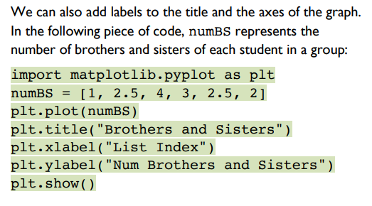
Labelling the graph

Slide 51
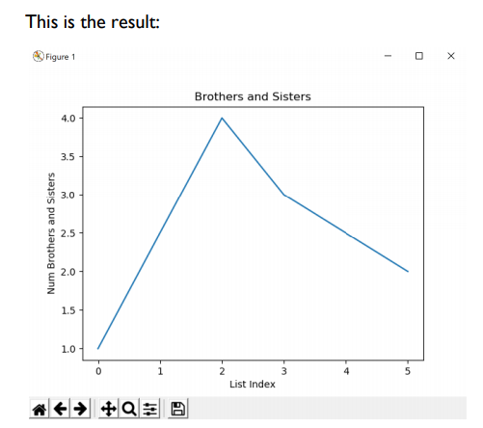

Slide 52
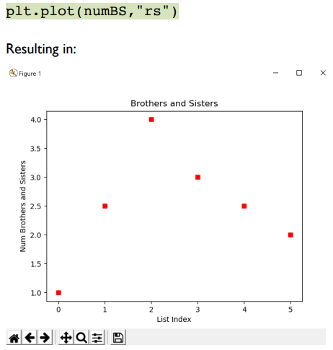
Graphing Options
A line graph may not always be suitable. For example, a line between points suggests that they are linked in some way.
The following code plots points, with no lines.

Slide 53
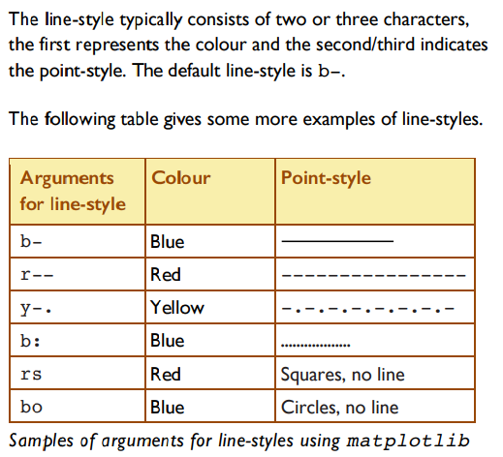

Slide 54
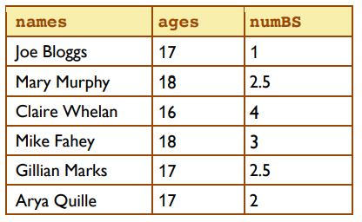
x and y axis
We can show labels on our axis.
Using the following table, we can graph the students and the number of brothers/sisters.
Note: there are two inputs so we
need two lists.

Slide 55
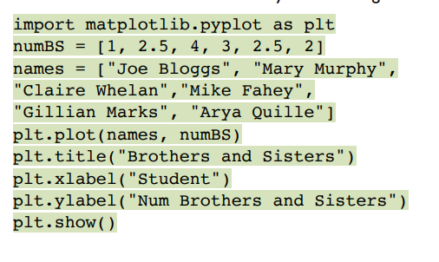
Note: The first argument represents the x-axis and the second argument represents the y-axis

Slide 56
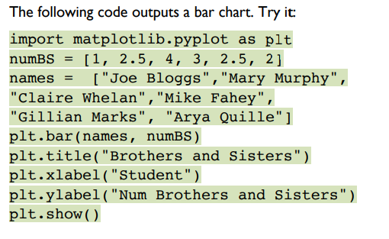
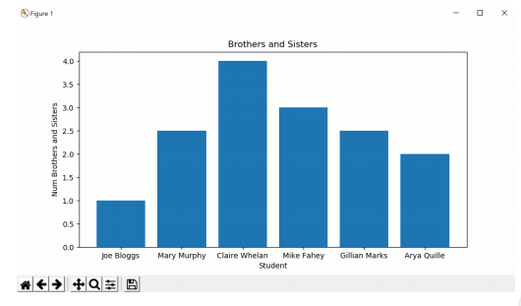
Additional plot types - Bar Chart
Bar

Slide 57
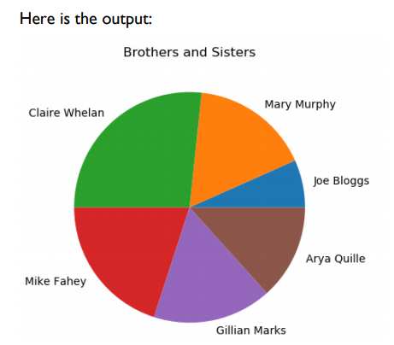
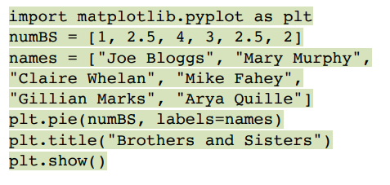
Pie Chart

Slide 58
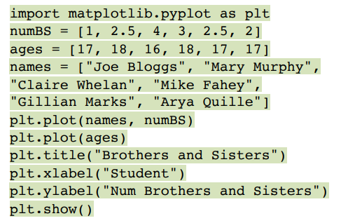
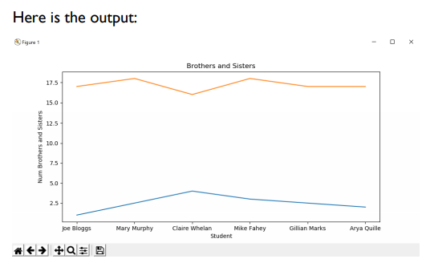
Displaying two datasets on one graph

Slide 59
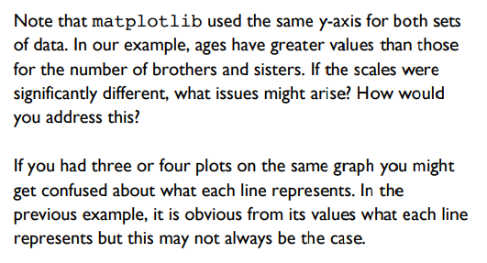

Slide 60
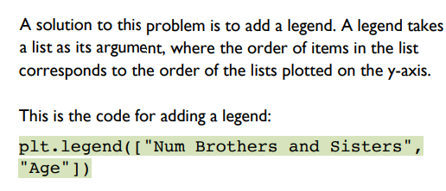

Slide 61
